Slide 1
DS&AI Project Case–based Reasoning
Marcello Bonsangue
LIACS – Leiden University
m.m.bonsangue@liacs.leidenuniv.nl
Reusing slides from Havily Janssen

Slide 2
Outline
Knowledge-base Systems
Model-based systems
Rules-based systems
Case-based reasoning

Slide 3
What is knowledge?
Knowledge is a theoretical or practical understanding of a subject or a domain. Knowledge is also the sum of what is currently known, and apparently knowledge is power. Those who possess knowledge are called experts.
Anyone can be considered a domain expert if he or she has deep knowledge (of both facts and rules) and strong practical experience in a particular domain. The area of the domain may be limited. In general, an expert is a skillful person who can do things other people cannot.

Slide 4
Knowledge based systems
KBS are one of the success stories of AI research
It has been around 30 years since the first documented KBS and in that time the basic architecture of KBS has changed little
The early KBS, and today’s systems, are based upon an explicit model of the knowledge required to solve a problem
Model-based KR
Rules-based KR

Slide 5
Outline
Knowledge-base Systems
Model-based systems
Rules-based systems
Case-based reasoning

Slide 6
Model-based KBS
A model-based system is based on a model of the structure and behavior of the device that the system is designed to simulate
Used for well structured problems
Not for stock pricing/modeling, not well structured
Engineering Problems
Ex: Diagnosing hardware or a machine
Ex: Automobile diagnostics
Based on written documentation
The problem is extracting knowledge

Slide 7
Model-based KBS
Observed behavior (what the device is actually doing) is compared with predicted behavior (what the device should do)
The difference between them is called a discrepancy, indicating a defect
Then a process is initiated to diagnose the nature and location of the defect
Could be a mathematical equation

Slide 8
Model-based KBS
Real
?
World
Problem
Reasoning
Analysis
System
Problem
Solution
Representation

Slide 9
Model-based KBS

Slide 10
Model-based KBS
Correct Operation:
Assume we have a model-based system built to diagnose the following simple device with 3 multipliers and 2 adders
Once the logic is developed, executes quickly

Slide 11
Model-based KBS
Incorrect Operation:
Diagnostics

Slide 12
Model-based KBS
Despite the undoubted success of model-based KBS in many sectors developers of these systems have met several problems:
knowledge elicitation (acquisition) is a difficult process, often being referred to as the knowledge elicitation bottleneck
implementing KBS is a difficult process requiring special skills and often taking many man years
once implemented model-based KBS are often slow and are unable to access or manage large volumes of information
once implemented they are difficult to maintain

Slide 13
Model-based KBS
Solutions to these problems have been proposed
better elicitation techniques and tools
better KBS shells and environments, improved development methodologies
knowledge modelling languages and ontologies
facilitating the co-operation between KBS and databases in expert databases and deductive databases
techniques and tools for maintaining systems

Slide 14
Outline
Knowledge-base Systems
Model-based systems
Rules-based systems
Case-based reasoning

Slide 15
Rules as a knowledge representation technique
The term rule in AI, which is the most commonly used type of knowledge representation, can be defined as an IF-THEN structure that relates given information or facts in the IF part to some action in the THEN part. A rule provides some description of how to solve a problem. Rules are relatively easy to create and understand.
Any rule consists of two parts: the IF part, called the antecedent (premise or condition) and the THEN part called the consequent (conclusion or action).

Slide 16
IF <antecedent>
THEN <consequent>
A rule can have multiple antecedents joined by the keywords AND (conjunction), OR (disjunction) or a combination of both.
IF <antecedent 1> IF <antecedent 1>
AND <antecedent 2> OR <antecedent 2>
. .
. .
. .
AND <antecedent n> OR <antecedent n>
THEN <consequent> THEN <consequent>

Slide 17
The antecedent of a rule incorporates two parts: an object (linguistic object) and its value. The object and its value are linked by an operator.
The operator identifies the object and assigns the value. Operators such as “is”, “are”, “is not”, “are not” are used to assign a symbolic value to a linguistic object.
Expert systems can also use mathematical operators to define an object as numerical and assign it to the numerical value.
IF ‘age of the customer’ <18
AND ‘cash withdrawal’ >1000
THEN ‘signature of parent’ is required

Slide 18
Rules can represent relations, recommendations, directives, strategies and heuristics:
Relation
IF the ‘fuel tank’ is empty
THEN the car is dead
Recommendation
IF the season is autumn
AND the sky is cloudy
AND the forecast is drizzle
THEN the advice is ‘take an umbrella’
Directive
IF the car is dead
AND the ‘fuel tank’ is empty
THEN the action is ‘refuel the car’

Slide 19
Strategy
IF the car is dead
THEN the action is ‘check the fuel tank’;
step1 is complete
IF step1 is complete
AND the ‘fuel tank’ is full
THEN the action is ‘check the battery’;
step2 is complete
Heuristic
IF the spill is liquid
AND the ‘spill PH’ <6
AND the ‘spill smell’ is vinegar
THEN the ‘spill material’ is ‘acetic acid’

Slide 20
Structure of a rule-based expert system
In the early 1970s, Newell and Simon from Carnegie-Mellon University proposed a production system model, the foundation of the modern rule-based expert systems.
The production model is based on the idea that humans solve problems by applying their knowledge (expressed as production rules) to a given problem represented by problem-specific information.
The production rules are stored in the long-term memory and the problem-specific information or facts in the short-term memory.

Slide 21
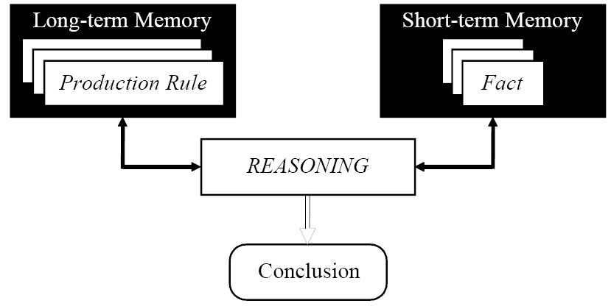
Production system model

Slide 22
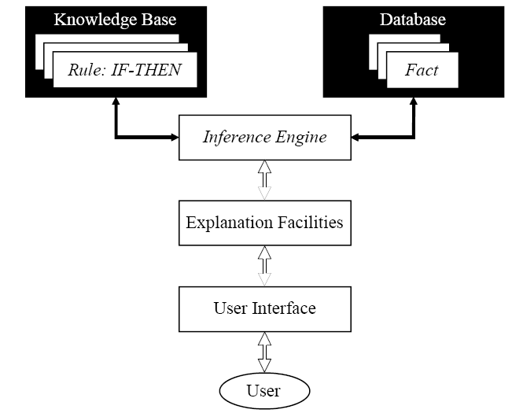
Basic structure of a rule-based knowledge system

Slide 23
The knowledge base contains the domain knowledge useful for problem solving. In a rule based expert system, the knowledge is represented as a set of rules. Each rule specifies a relation, recommendation, directive, strategy or heuristic and has the IF (condition) THEN (action) structure. When the condition part of a rule is satisfied, the rule is said to fire and the action part is executed.
The database includes a set of facts used to match against the IF (condition) parts of rules stored in the knowledge base.

Slide 24
The inference engine carries out the reasoning whereby the expert system reaches a solution. It links the rules given in the knowledge base with the facts provided in the database.
The explanation facilities enable the user to ask the expert system how a particular conclusion is reached and why a specific fact is needed. An expert system must be able to explain its reasoning and justify its advice, analysis or conclusion.
The user interface is the means of communication between a user seeking a solution to the problem and an expert system.

Slide 25
Forward chaining and backward chaining
In a rule-based knowledge system, the domain knowledge is represented by a set of IF-THEN production rules and data is represented by a set of facts about the current situation. The inference engine compares each rule stored in the knowledge base with facts contained in the database. When the IF (condition) part of the rule matches a fact, the rule is fired and its THEN (action) part is executed.
The matching of the rule IF parts to the facts produces inference chains. An inference chain indicates how an expert system applies the rules to reach a conclusion.

Slide 26
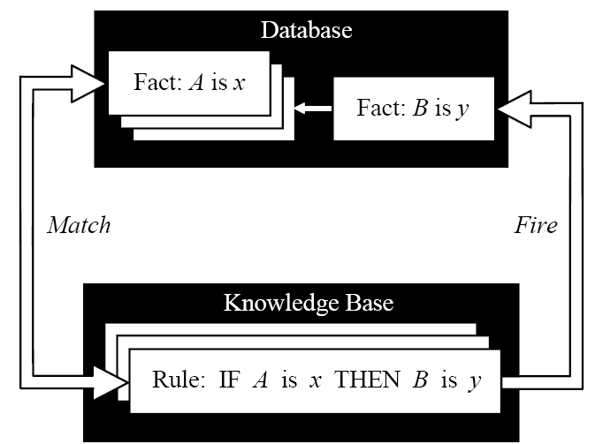
Inference engine cycles via a match-fire procedure

Slide 27
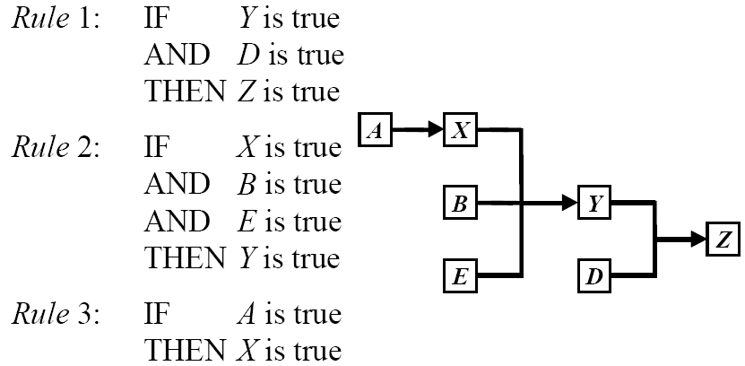
An example of an inference chain

Slide 28
Forward chaining
Forward chaining is the data-driven reasoning. The reasoning starts from the known data and proceeds forward with that data. Each time only the topmost rule is executed. When fired, the rule adds a new fact in the database. Any rule can be executed only once. The match-fire cycle stops when no further rules can be fired.

Slide 29
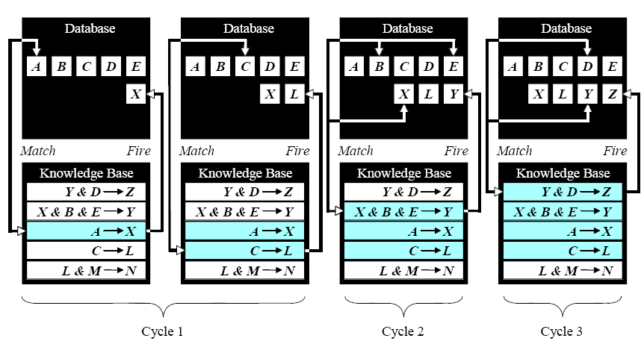
Forward chaining

Slide 30
Forward chaining
Forward chaining is a technique for gathering information and then inferring from it whatever can be inferred.
However, in forward chaining, many rules may be executed that have nothing to do with the established goal.
Therefore, if our goal is to infer only one particular fact, the forward chaining inference technique would not be efficient.

Slide 31
Backward chaining
Backward chaining is the goal-driven reasoning. In backward chaining, an expert system has the goal (a hypothetical solution) and the inference engine attempts to find the evidence to prove it. First, the knowledge base is searched to find rules that might have the desired solution. Such rules must have the goal in their THEN (action) parts. If such a rule is found and its IF (condition) part matches data in the database, then the rule is fired and the goal is proved. However, this is rarely the case.

Slide 32
Backward chaining
Thus, the interference engine puts aside the rule it is working with (the rule said to stack) and sets up a new goal, a subgoal, to prove the IF part of this rule. Then the knowledge base is searched again for rules that can prove the subgoal. The inference engine repeats the process of stacking the rules until no rules are found in the knowledge base to prove the current subgoal.

Slide 33
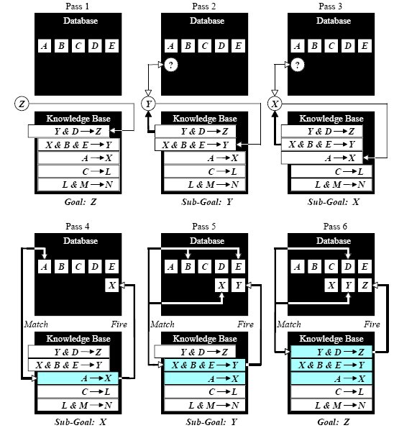
Backward chaining

Slide 34
How do we choose between forward and backward chaining?
If an expert first needs to gather some information then tries to infer from it whatever can be inferred, choose the forward chaining inference engine.
However, if your expert begins with a hypothetical solution and the attempts to find facts to prove it, choose the backward inference engine.

Slide 35
Conflict resolution
Consider two simple rules for crossing a road. Let us add third rule.
Rule 1:
IF the ‘traffic light’ is green
THEN the action is go
Rule 2:
IF the ‘traffic light’ is red
THEN the action is stop
Rule 3:
IF the ‘traffic light’ is red
THEN the action is go

Slide 36
We have two rules. Rule 2 and Rule 3, with the same IF part. Thus both of them can be set to fire when the condition part is satisfied. These rules represent a conflict set. The inference engine must determine which rule to fire from such a set. A method for choosing a rule to fire when more than one rule can be fired in a given cycle is called conflict resolution.

Slide 37
In forward chaining. Both rules would be fired. Rule 2 is fired first as the topmost one and linguistic object action obtains value stop. However, Rule 3 is also fired because the condition part of this rule matches the fact traffic light is red, which is still in the database. Consequently, object action takes new value go.

Slide 38
Methods used for conflict resolution
Fire the rule with the highest priority, in simple applications, the priority can be established by placing the rules in an appropriate order in the knowledge base. Usually this strategy works well for expert systems with around 100 rules.
Fire the most specific rule (a largest number of conditions). This method is also known as the longest matching strategy. It assumes that a specific rule processes more information than a general one.

Slide 39
Fire the rule that uses the data most recently entered in the database. This method relies on time tags attached to each fact in the database. In the conflict set, the expert system first fires the rule whose antecedent uses the data most recently added to the database.

Slide 40
Advantages of rule-based knowledge systems
Natural Knowledge representation. An expert usually explains the problem-solving procedure with such expressions as this: "In such-and-such situation, I do so-and-so”. These expressions can be represented quite naturally as IF-THEN production rules.
Uniform structure. Production rules have the uniform IF-THEN structure. Each rule is an independent piece of knowledge. The very syntax of production rules enables them to be self documented.

Slide 41
Advantages of rule-based expert systems
Separation of knowledge from its processing. The structure of a rule-based system provides an effective separation of the knowledge form the inference engine. This makes it possible to develop different applications using the same expert system shell.
Dealing with incomplete and uncertain knowledge. Most rule-based systems can represent and reasoning with incomplete and uncertain knowledge.

Slide 42
Disadvantages of rule-based expert systems
Opaque relations between rules. Although individual production rules are relatively simple and self-documented, their logical interactions within a large set of rules may be opaque. Rule-based systems make it difficult to observe how individual rules serve the overall strategy.
Ineffective search strategy. The inference engine applies an exhaustive search through all the production rules during each cycle. Systems with a large set of rules (over 100 rules) can be slow, and thus large rule-based systems can be unsuitable for real-time applications.

Slide 43
Disadvantages of rule-based systems
Inability to lean. In general, rule-based systems do not have an ability to learn from the experience. Unlike a human expert, who knows when to “break the rules”, an expert system cannot automatically modify its knowledge base, or adjust existing rules or add new ones. The knowledge engineer is still responsible for revising and maintaining the system.

Slide 44
Outline
Knowledge-base Systems
Model-based systems
Rules-based systems
Case-based reasoning

Slide 45
Case-based Reasoning
Over the last few years an alternative reasoning paradigm and computational problem-solving method has increasingly attracted more and more attention
Case-based reasoning (CBR) solves new problems by adapting previously successful solutions to similar problems
CBR is attracting attention because it seems to directly address the problems outlined above

Slide 46
Case-based Reasoning
Namely:
CBR does not require an explicit domain model and so elicitation becomes a task of gathering case histories
implementation is reduced to identifying significant features that describe a case, an easier task than creating an explicit model
by applying database techniques large volumes of information can be managed
CBR systems can learn by acquiring new knowledge as cases thus making maintenance easier

Slide 47
Case-based Reasoning
Retrieve a similar case
and adapt the solution to
fit the current problem

Slide 48
The CBR Assumption
New problem can be solved by
retrieving similar problems
adapting retrieved solutions
Similar problems have similar solutions
P
P
P
P
?
P
P
P
P
P
S
S
S
X
S
S
S
S
S
S

Slide 49
Case-based Reasoning Applications
Medicine
doctor remembers previous patients especially for rare combinations of symptoms
Law
Many laws depends on precedent cases
case histories are consulted
Management
decisions are often based on past rulings
Financial
performance is predicted by past results

Slide 50
Case-based Reasoning Applications
e-Commerce
sales support for standard products
sales support for customized products
Planning
mission planning
route planning
Personalization
TV listings from
music on demand
news stories

Slide 51
The CBR Cycle
Problem
Similar
Cases
RETRIEVE
RETAIN
REUSE
Prior
Cases
Case-Base
New
Solution
REVISE
Solution?

Slide 52
The CBR Cycle
CBR typically as a cyclical process comprising the four REs:
RETRIEVE the most similar case(s);
REUSE the case(s) to attempt to solve the problem;
REVISE the proposed solution if necessary, and
RETAIN the new solution as a part of a new case.

Slide 53
The CBR Cycle
This cycle currently rarely occurs without human intervention.
For example many CBR tools act primarily as case retrieval and reuse systems.
Case revision (i.e., adaptation) often being undertaken by managers of the case base.
However, it should not be viewed as weakness of CBR that it encourages human collaboration in decision support.

Slide 54
Issues in CBR
There are five important issues in Case-based reasoning:
Case representation
Indexing - Storage
Retrieval
Adaptation

Slide 55
Case Representation
A case is a contextualised piece of knowledge representing an experience.
It contains the past lesson that is the content of the case and the context in which the lesson can be used.
Typically a case comprises:
the problem that describes the state of the world when the case occurred,
the solution which states the derived solution to that problem, and/or
the outcome which describe the state of the world after the case occurred.

Slide 56
Case Representation
Cases can be represented in a variety of forms using the full range of KR formalisms
frames, objects, predicates, semantic nets and rules
the frame/object representation currently being used by the majority of CBR software.

Slide 57
Indexing
Case indexing involves assigning indices to cases to facilitate their retrieval. Indices should:
be predictive,
address the purposes the case will be used for,
be abstract enough to allow for widening the future use of the case-base
be concrete enough to be recognised in future

Slide 58
Indexing
Both manual and automated methods have been used to select indices.
Automated indexing methods include:
Indexing cases by features and dimensions
Difference-based indexing selects indices that differentiate a case from other cases.
Similarity and explanation-based generalisation methods, which produce an appropriate set of indices for abstract cases created from cases that share some common set of features, whilst the unshared features are used as indices to the original cases

Slide 59
Storage
Case storage is an important aspect in designing efficient CBR systems
The case-base should be organised into a manageable structure that supports efficient search and retrieval methods.
A balance has to be found between storing methods that preserve the semantic richness of cases and their indices and methods that simplify the access and retrieval of relevant cases.
These methods are usually referred to as case memory models. The most influential case memory model is the dynamic memory model

Slide 60
The dynamic memory model
The case memory model in this method is comprised of memory organisation packets or MOPs.
MOPs are a form of frame and are the basic unit in dynamic memory. They can be used to represent knowledge about classes of events using:
instances representing cases, events or objects, and
abstractions representing generalised versions of instances or of other abstractions

Slide 61
The dynamic memory model
The case memory, in a dynamic memory model, is a hierarchical structure of MOPs, also referred to as generalised episodes (GEs)
The basic idea is to organise specific cases which share similar properties under a more general structure (i.e., a generalised episode).
A GE contains three different types of objects: norms, cases and indices.
Norms are features common to all cases indexed under a GE.
Indices are features which discriminate between a GE’s cases.

Slide 62
The dynamic memory model
The case-memory is a network where nodes are either a GE, an index name, index value or a case.
Index name-value pairs point from a GE to another GE or case.
The primary role of a GE is as an indexing structure for storing, matching and retrieval of cases.
During case storage when a feature (i.e., index name and index value) of a new case matches a feature of an existing case a new GE is created.
The two cases are then discriminated by indexing them under different indices below the new GE (assuming the cases are not identical).
Thus, the memory is dynamic in that similar parts of two cases are dynamically generalised into a new GE, the cases being indexed under the GE by their differences.

Slide 63
Retrieval
Given a description of a problem, a retrieval algorithm, using the indices in the case-memory, should retrieve the most similar cases to the current problem or situation.
The retrieval algorithm relies on the indices and the organisation of the memory to direct the search to potentially useful cases
Case-based reasoning will be ready for large scale problems only when retrieval algorithms are efficient at handling thousands of cases.
Unlike database searches that target a specific value in a record, retrieval of cases from the case-base must be equipped with heuristics that perform partial matches, since in general there is no existing case that exactly matches the new case.

Slide 64
Retrieval
Case-based reasoning will be ready for large scale problems only when retrieval algorithms are efficient at handling thousands of cases.
Unlike database searches that target a specific value in a record, retrieval of cases from the case-base must be equipped with heuristics that perform partial matches, since in general there is no existing case that exactly matches the new case.

Slide 65
Retrieval
Among well known methods for case retrieval are:
nearest neighbour
induction
knowledge guided induction
template retrieval
These methods can be used alone or combined into hybrid retrieval strategies.

Slide 66
Nearest neighbour
This approach involves the assessment of similarity between stored cases and the new input case, based on matching a weighted sum of features.
The biggest problem here is to determine the weights of the features.
The limitation of this approach include problems in converging on the correct solution and retrieval times.
In general the use of this method leads to the retrieval time increasing linearly with the number of cases.
Therefore this approach is more effective when the case base is relatively small.

Slide 67
Nearest Neighbour Retrieval
Retrieve most similar
k-nearest neighbour
k-NN
like scoring in bowls or curling
Example
1-NN
5-NN

Slide 68
How do we measure similarity?
Distances between values of individual features
problem and case have values p and c for feature f
Numeric features
δf(problem,case) = |p - c|/(max difference)
Symbolic features
δf(problem,case) = if p = c then 0 else 1
Distance is Δ(problem,case)
weighted sum of δf(problem,case) for all features
Similarity(problem, case) = 1/(1+ Δ(problem,case))

Slide 69
Why do we want an index?
Efficiency
if similarity matching is computationally expensive
Pre-selection of relevant cases
some features of new problem may make certain cases irrelevant . . .
despite being very similar

Slide 70
Induction
Induction algorithms determine which features do the best job in discriminating cases, and generate a decision tree type structure to organise the cases in memory.
This approach is useful when a single case feature is required as a solution, and where that case feature is dependent upon others.

Slide 71
Knowledge guided induction
This method applies knowledge to the induction process by manually identifying case features that are known or thought to affect the primary case feature.
This approach is frequently used in conjunction with other techniques, because the explanatory knowledge is not always readily available for large case bases.

Slide 72
Template retrieval
Similar to SQL-like queries, template retrieval returns all cases that fit within certain parameters.
This technique is often used before other techniques, such as nearest neighbour, to limit the search space to a relevant section of the case-base

Slide 73
Adaptation
Once a matching case is retrieved a CBR system should adapt the solution stored in the retrieved case to the needs of the current case.
Adaptation looks for prominent differences between the retrieved case and the current case and then applies formulae or rules that take those differences into account when suggesting a solution.

Slide 74
Adaptation
In general, there are two kinds of adaptation in CBR:
Structural adaptation in which adaptation rules are applied directly to the solution stored in cases
Derivational adaptation that reuses the algorithms, methods or rules that generated the original solution to produce a new solution to the current problem. In this method the planning sequence that constructed that original solution must be stored in memory along with the solution
An ideal set of adaptation rules must be strong enough to generate complete solutions from scratch
An efficient CBR system may need both structural adaptation rules to adapt poorly understood solutions and derivational mechanisms to adapt solutions of cases that are well understood

Slide 75
Adaptation
Several techniques, ranging from simple to complex, have been used in CBR for adaptation:
Null adaptation a direct simple technique that applies whatever solution is retrieved to the current problem without adapting it. Null adaptation is useful for problems involving complex reasoning but with a simple solution.
For example, when someone applies for a bank loan, after answering numerous questions the final answer is very simple: grant the loan, reject the loan, or refer the application.

Slide 76
Adaptation
Parameter adjustment a structural adaptation technique that compares specified parameters of the retrieved and current case to modify the solution in an appropriate direction.
This technique is used in JUDGE, which recommends a shorter sentence for a criminal where the crime was less violent.

Slide 77
Adaptation
Abstraction and respecialisation a general structural adaptation technique that is used in a basic way to achieve simple adaptations and in a complex way to generate novel, creative solutions.
Critic-based adaptation in which a critic looks for combinations of features that can cause a problem in a solution. Importantly, the critic is aware of repairs for these problems.

Slide 78
Adaptation
Reinstantiation is used to instantiate features of an old solution with new features. For example, CHEF can reinstantiate chicken and snow peas in a Chinese recipe with beef and broccoli thereby creating a new recipe.
Derivational replay is the process of using the method of deriving an old solution or solution piece to derive a solution in the new situation. For example, BOGART, which replays stored design plans to solve problems.

Slide 79
Adaptation
Model-guided repair uses a causal model to guide adaptation as in CELIA, which is used for diagnosis and learning in auto mechanics, and KRITIK used in the design of physical devices.
Case-based substitution uses cases to suggest solution adaptation as in ACBARR a system for robot navigation

Slide 80
An Example: Diagnosis of Car Faults
Given:
Symptoms
e.g. engine doesn’t start
and measured values
e.g. battery voltage = 6.3V
Goal:
Find cause for fault
e.g. dead battery
and repair strategy
e.g. charge battery

Slide 81
Diagnosis of Car Faults - Cases
CASE 1
CASE 2
Problem & Features
Problem: Front light not working
Car: VW Golf, 2.0L
Year: 1999
Battery voltage: 13.6V
State of lights: OK
State of light switch: OK
Solution
Diagnosis: Front light fuse defect
Repair: Replace front light fuse
Problem & Features
Problem: Front light not working
Car: Passat
Year: 2000
Battery voltage: 12.6V
State of lights: surface damaged
State of light switch: OK
Solution
Diagnosis: Bulb defect
Repair: Replace front light

Slide 82
Diagnosis of Car Faults
New Problem
Observations define a new problem
Not all feature values may be known
New problem = case without solution
Problem & Features
Problem: Brake light not working
Car: Passat V6
Year: 2002
Battery voltage: 12.9V
State of lights: OK
State of light switch: ?

Slide 83
Diagnosis of Car Faults
Find Similar Case
CASE X
Problem & Features
…
Solution
…
New Problem
SIMILAR?
Compare similarity of each feature
But some features may be more important

Slide 84
Compare with Case 1
CASE 1
Problem & Features
Problem: Front light not working
Car: VW Golf, 2.0L
Year: 1999
Battery voltage: 13.6V
State of lights: OK
State of light switch: OK
Solution
Diagnosis: Front light fuse defect
Repair: Replace front light fuse
Problem & Features
Problem: Brake light not working
Car: Passat V6
Year: 2002
Battery voltage: 12.9V
State of lights: OK
State of light switch: ?
Very important
Less important

Slide 85
Compare with Case 1
Similarity by wtd avg = 1/20 (6*0.8 + 1*0.4 + 1*0.7 + 6*0.9 + 6*1.0) = 0.87
CASE 1
Problem & Features
Problem: Front light not working
Car: VW Golf, 2.0L
Year: 1999
Battery voltage: 13.6V
State of lights: OK
State of light switch: OK
Solution
Diagnosis: Front light fuse defect
Repair: Replace front light fuse
Problem & Features
Problem: Brake light not working
Car: Passat V6
Year: 2002
Battery voltage: 12.9V
State of lights: OK
State of light switch: ?
0.8
0.4
0.7
0.9
1.0
Very important
Less important

Slide 86
Compare with Case 2
Similarity by wtd avg = 1/20 (6*0.8 + 1*0.8 + 1*0.8 + 6*0.9 + 6*0.0) = 0.59
CASE 2
Problem & Features
Problem: Front light not working
Car: Passat
Year: 2000
Battery voltage: 12.6V
State of lights: surface damaged
State of light switch: OK
Solution
Diagnosis: Bulb defect
Repair: Replace front light
Problem & Features
Problem: Brake light not working
Car: Passat V6
Year: 2002
Battery voltage: 12.9V
State of lights: OK
State of light switch: ?
0.8
0.8
0.8
0.9
0.0
Very important
Less important

Slide 87
Reuse Case 1
Problem & Features
Problem: Brake light not working
…
CASE 1
adapt
Problem & Features
Problem: Front light not working
Solution
Diagnosis: Front light fuse defect
Repair: Replace front light fuse
New Solution
Diagnosis: Brake light fuse defect
Repair: Replace break light fuse

Slide 88
Store New Case
CASE 3
Problem & Features
Problem: Break light not working
Car: Passat V6
Year: 2002
Battery voltage: 12.9V
State of lights: OK
State of light switch: OK
Solution
Diagnosis: Brake light fuse defect
Repair: Replace break light fuse

Slide 89
CBR example: Property pricing
Test instance
Notes:
Put this slide on the OHP

Slide 90
How are adaptation rules generated?
There is no unique way of doing it. Here is one possibility:
Examine cases and look for ones that are almost identical
case 1 and case 2
R1: If recep-rooms changes from 2 to 1 then reduce price by £5,000
case 3 and case 4
R2: If Type changes from semi to terraced then reduce price by £7,000

Slide 91
Matching
Comparing test instance
matches(5,1) = 3
matches(5,2) = 3
matches(5,3) = 2
matches(5,4) = 1
Estimate price of case 5 is £25,000
Notes:
The matching items in case 1 are
number of bedrooms
number of floors
condition
The matching items in case 2 are
number of bedrooms
number of reception rooms
number of floors
Suppose for the sake of argument that we have a rule in the rule-base that says (within reason) that the number of reception rooms is more important than the condition.
So we would say that case 2 was the best match and estimate the price of property 5 as £25,000

Slide 92
Adapting
Reverse rule 2
if type changes from terraced to semi then increase price by £7,000
Apply reversed rule 2
new estimate of price of property 5 is £32,000
Notes:
Adapting may involve adapting rule in the rule-base and then applying them to the closest matching case.
Thus we finally suggest that property 5 should fetch £32,000

Slide 93
CBR vs Rule-based KBS
Rule-based
a rule is generalised experience
applies to range of examples
currently do not learn as they solve problems
knowledge acquisition bottleneck
Case-based reasoning
cases include both prototypical cases and exceptions
indexing, similarity and adaptation control effectiveness
domain does not have an effective underlying theory
learning updates case-base
knowledge acquisition?
retrieval and adaptation knowledge

Slide 94
Pros & Cons of CBR
Advantages
solutions are quickly proposed
derivation from scratch is avoided
domains do not need to be completely understood
cases useful for open-ended/ill-defined concepts
highlights important features
Disadvantages
old cases may be poor
library may be biased
most appropriate cases may not be retrieved
retrieval/adaptation knowledge still needed

